Slide 1
Solutions
13/08/2023
Dr. Muhammed Shah Miran
Professor, Department of Chemistry
University of Dhaka, Dhaka 1000

Slide 2
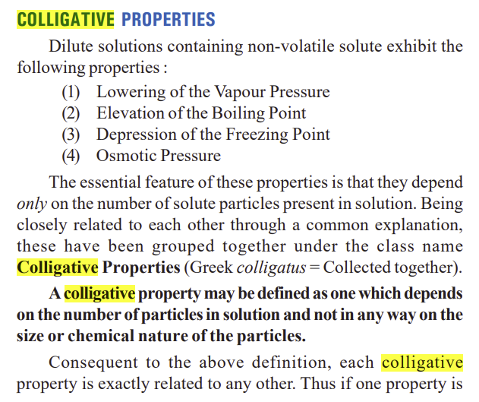
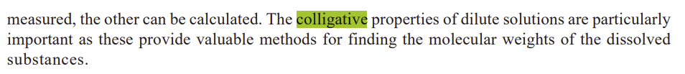

Slide 3
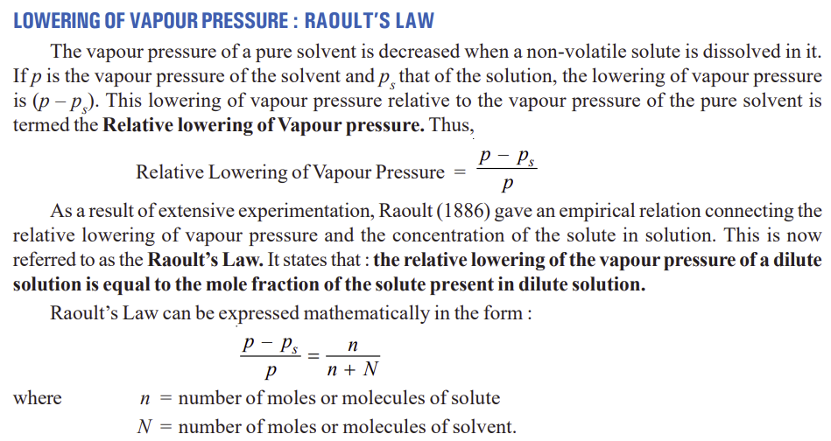

Slide 4
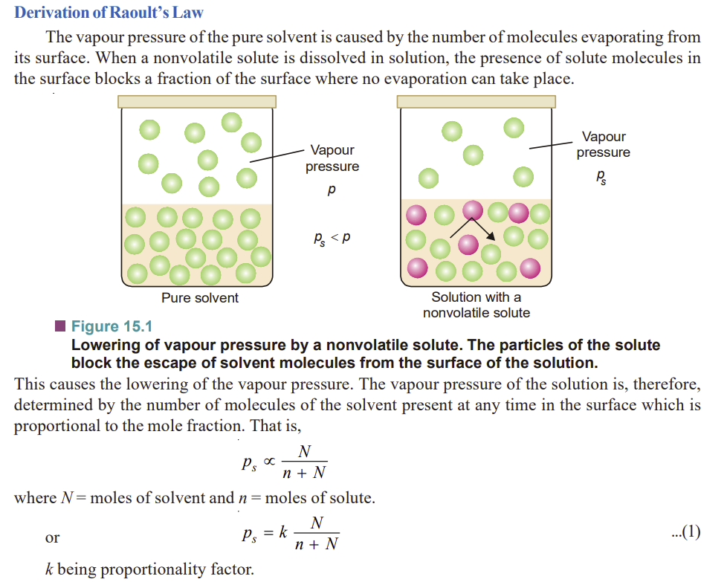

Slide 5
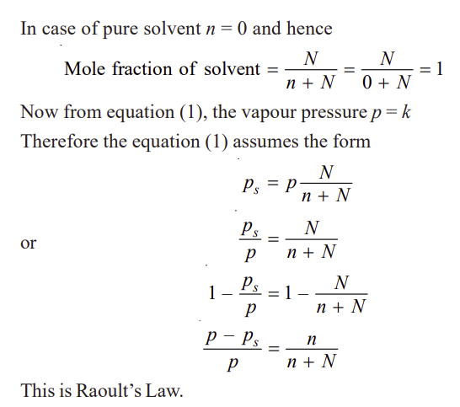

Slide 6
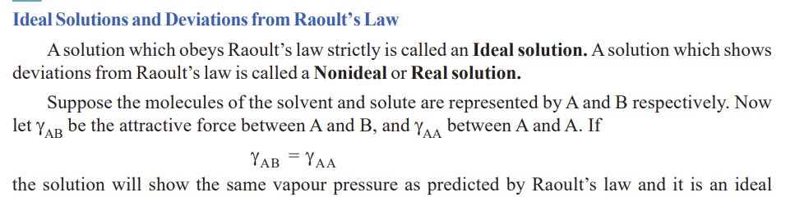

Slide 7
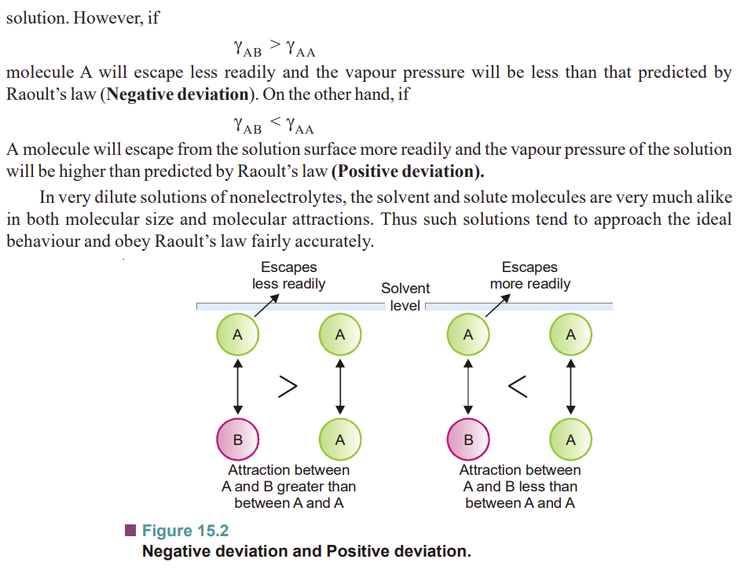

Slide 8
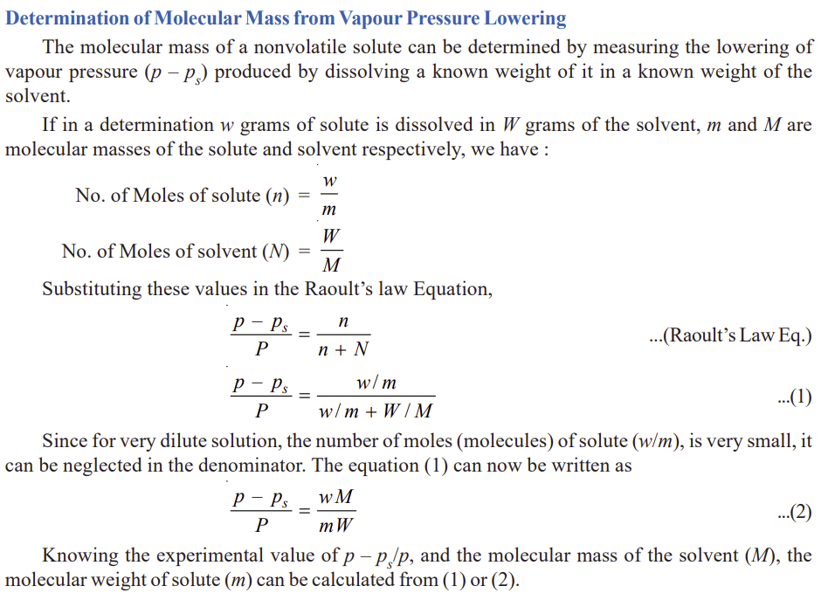


Slide 9
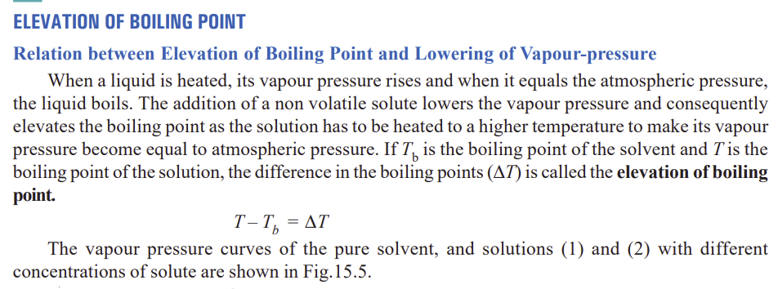

Slide 10
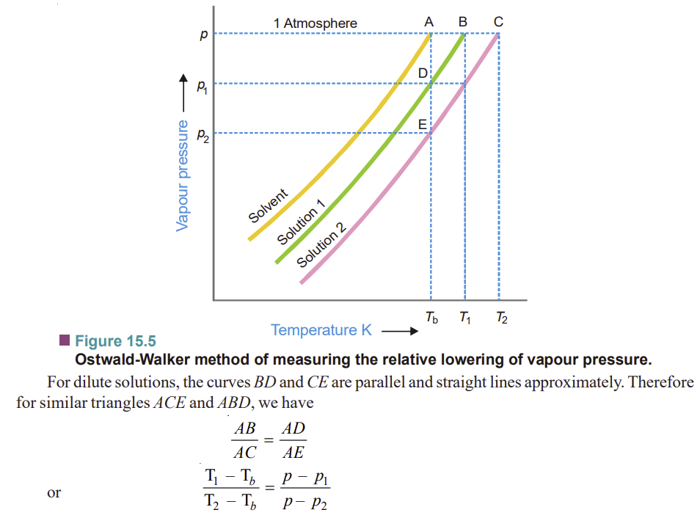

Slide 11
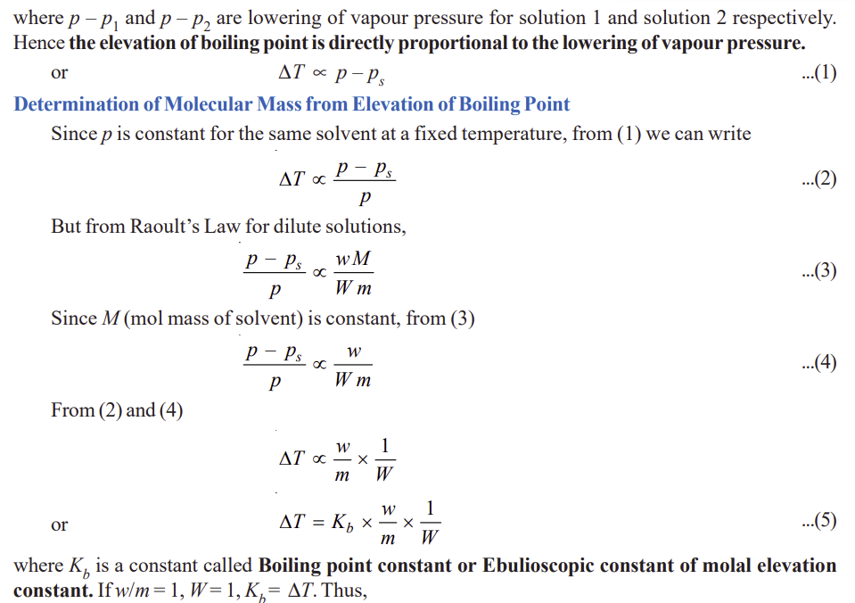

Slide 12
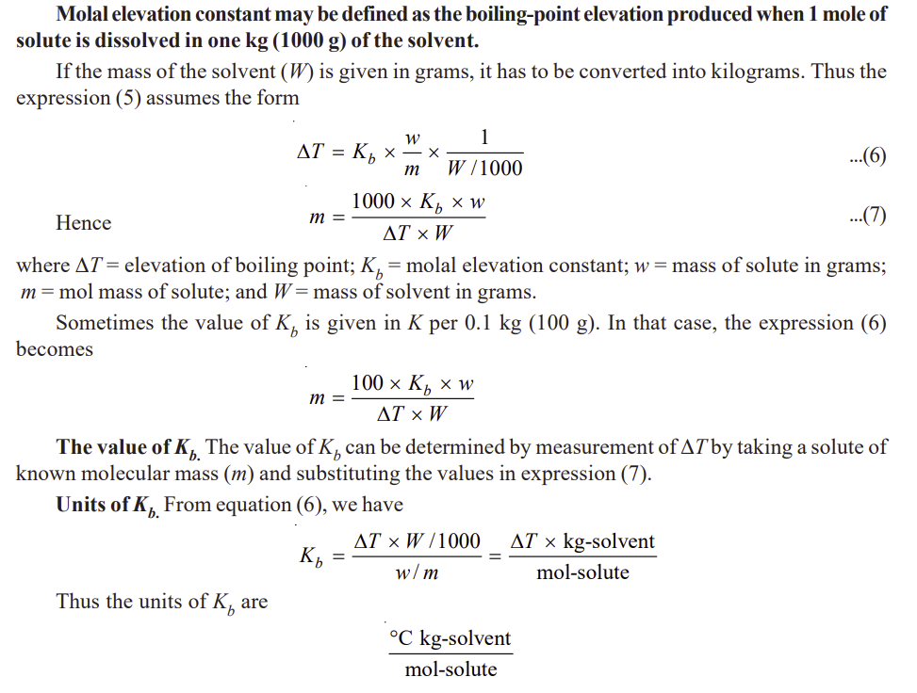

Slide 13
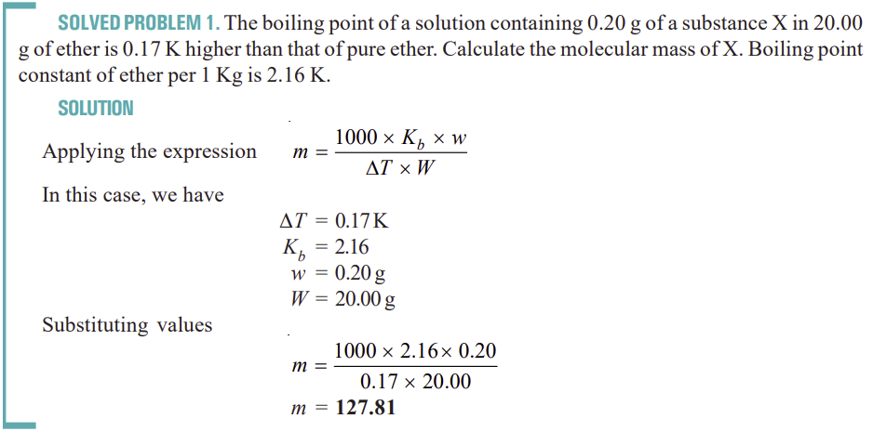

Slide 14
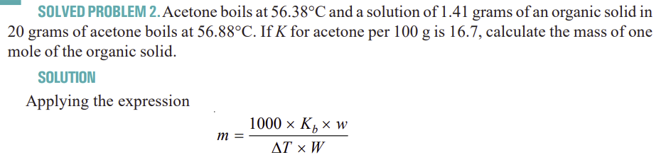
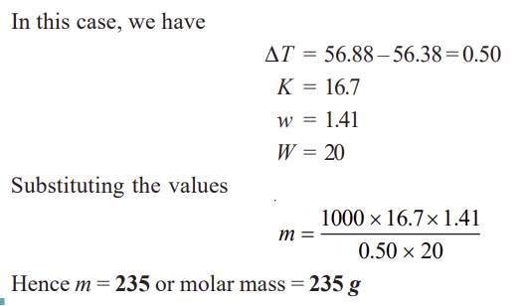

Slide 15
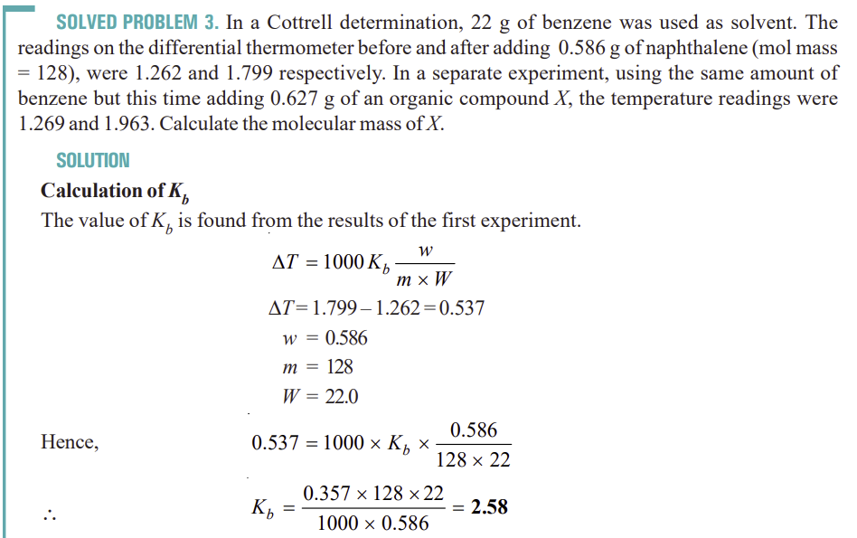

Slide 16
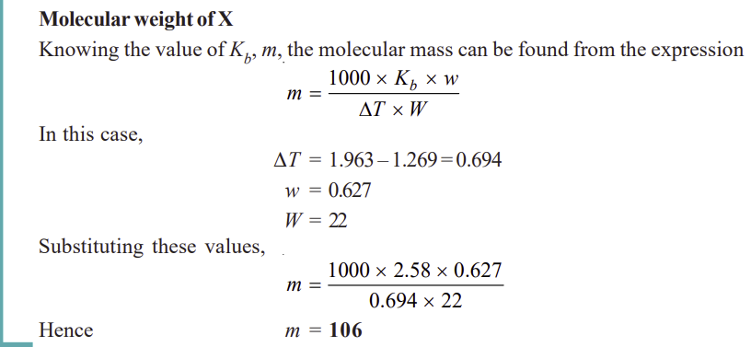

Slide 17
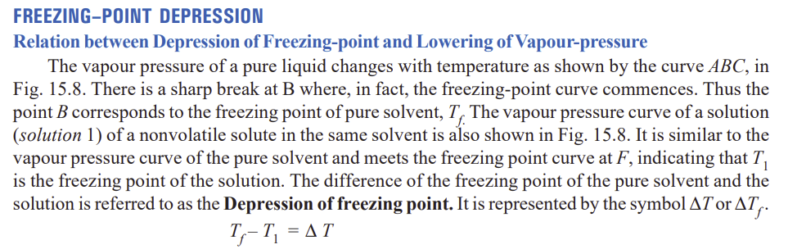

Slide 18
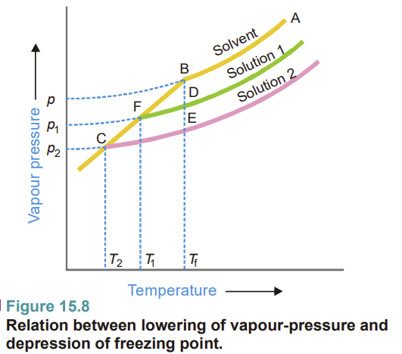

Slide 19
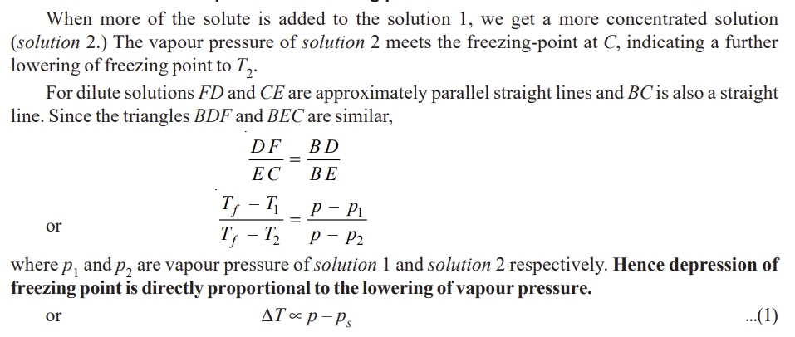

Slide 20
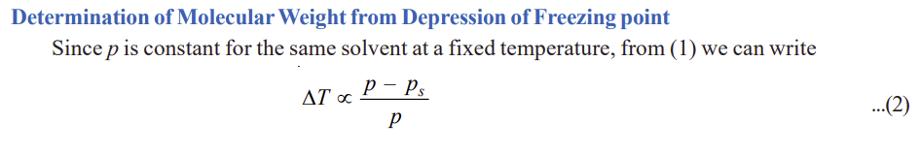
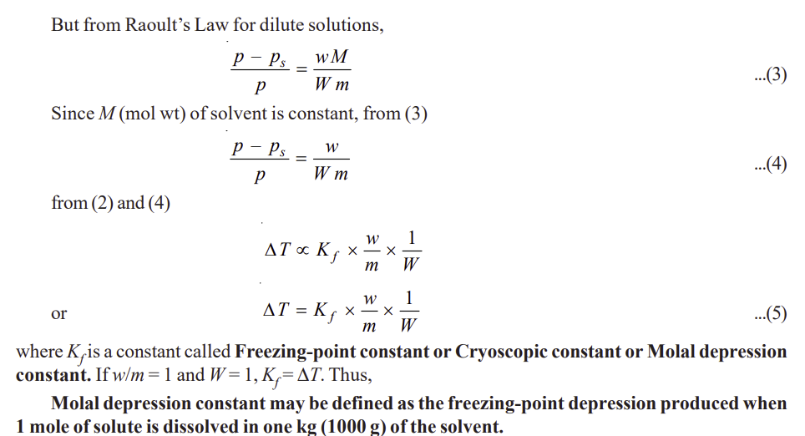

Slide 21
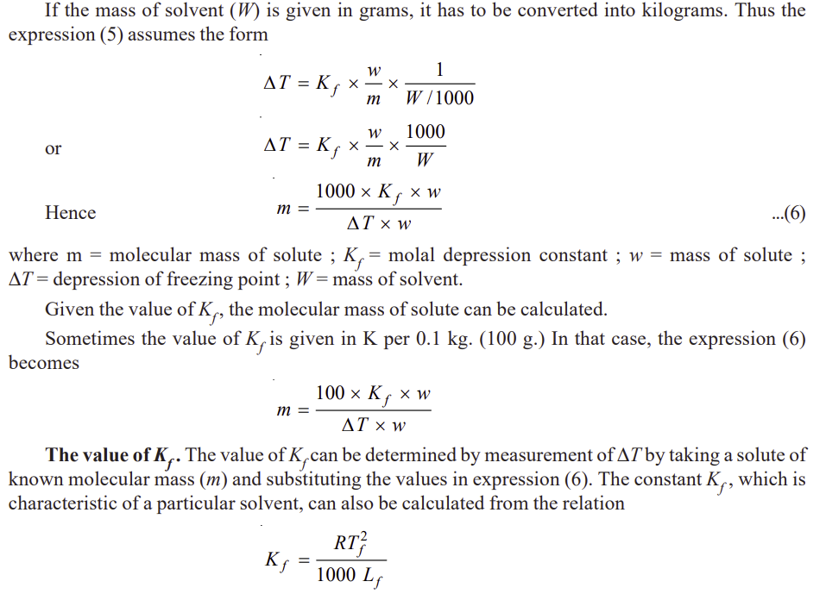

Slide 22
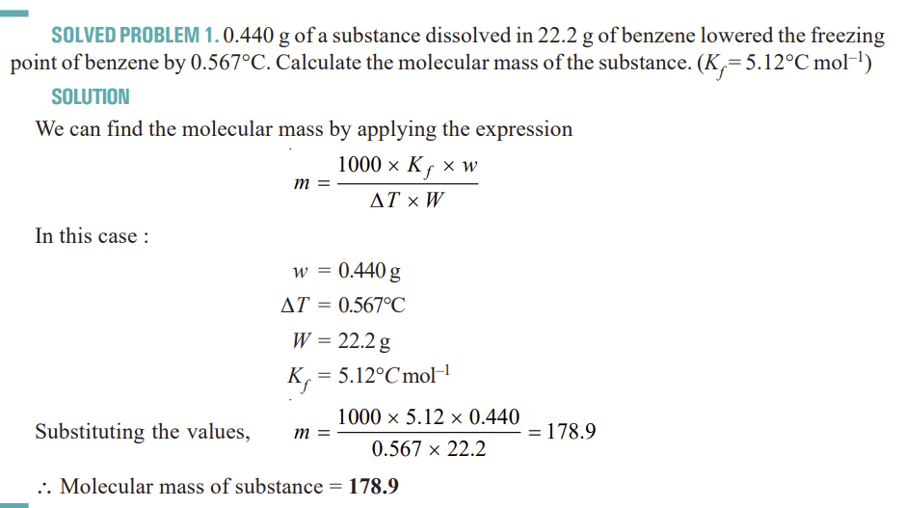

Slide 23
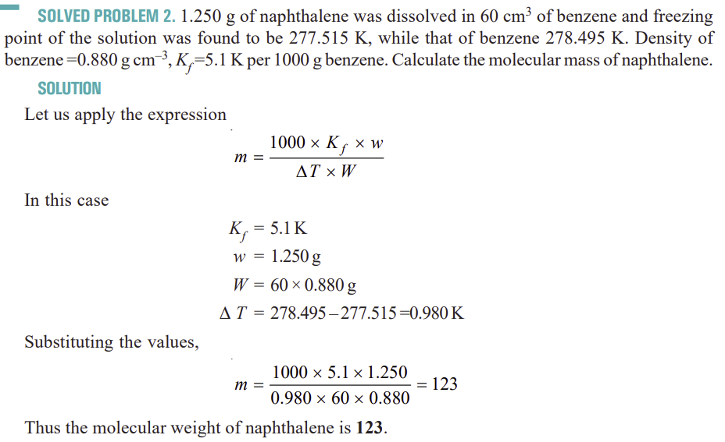

Slide 24
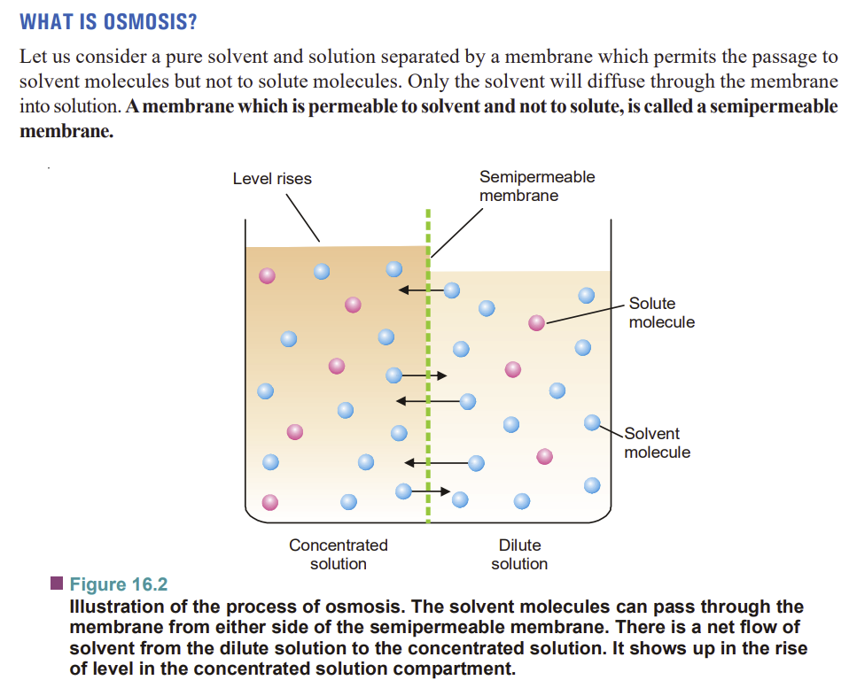

Slide 25
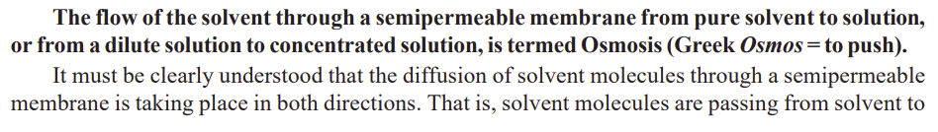
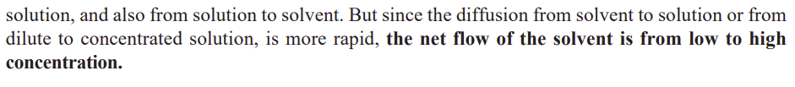

Slide 26
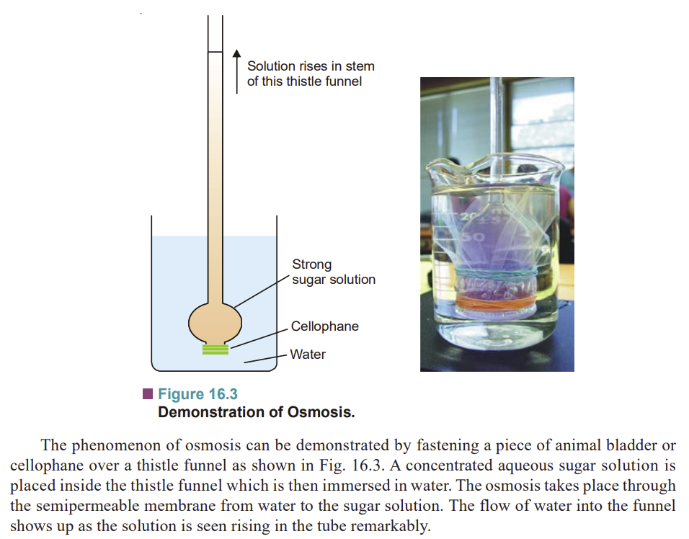

Slide 27
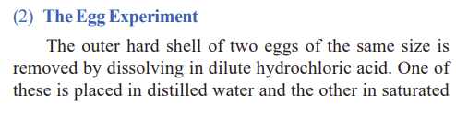
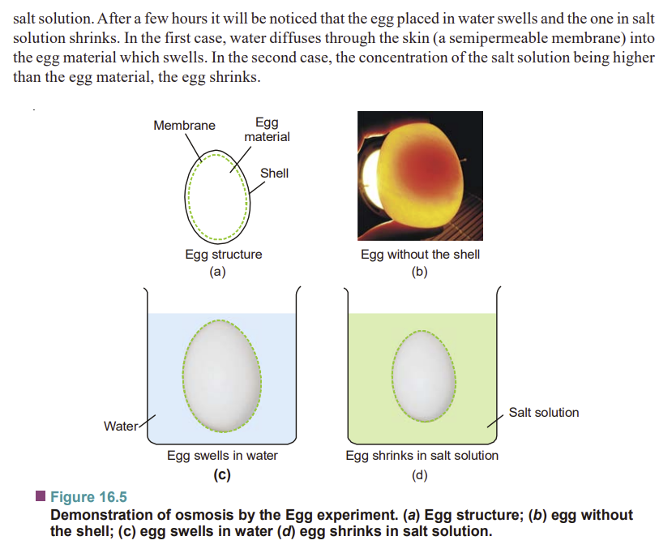

Slide 28
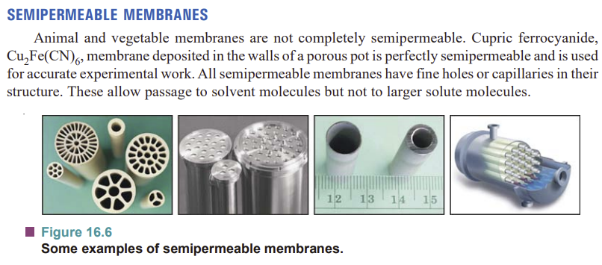

Slide 29
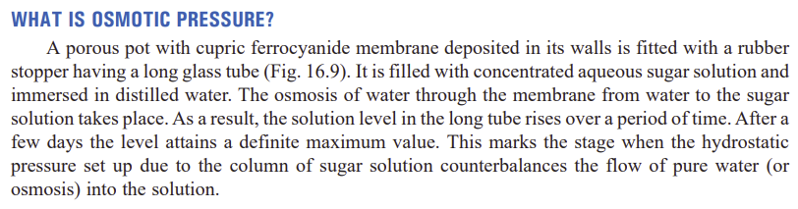

Slide 30
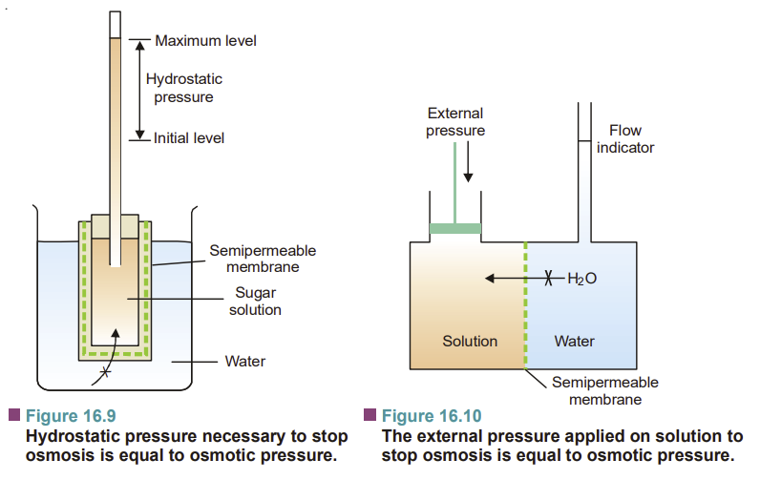

Slide 31
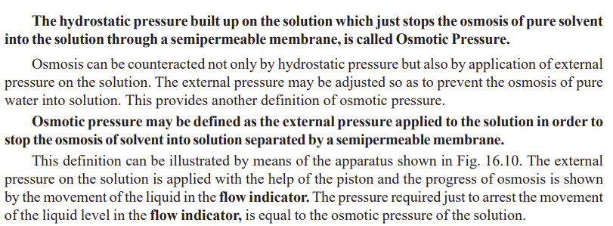

Slide 32
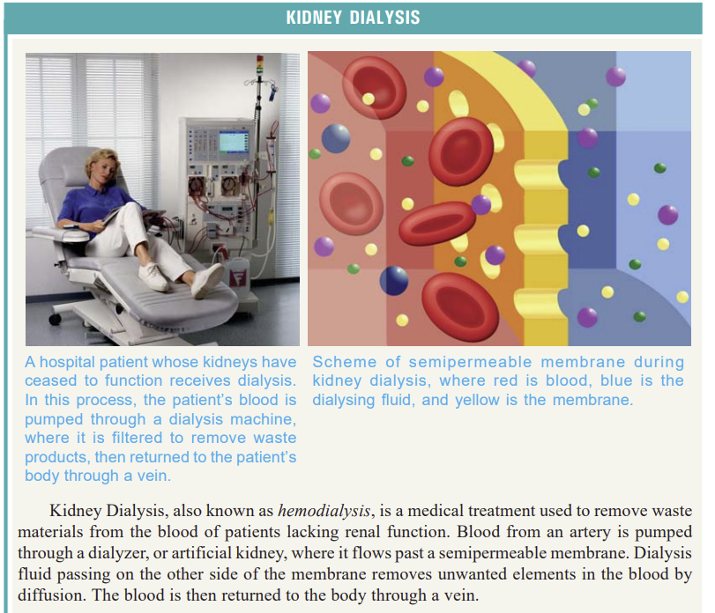

Slide 33
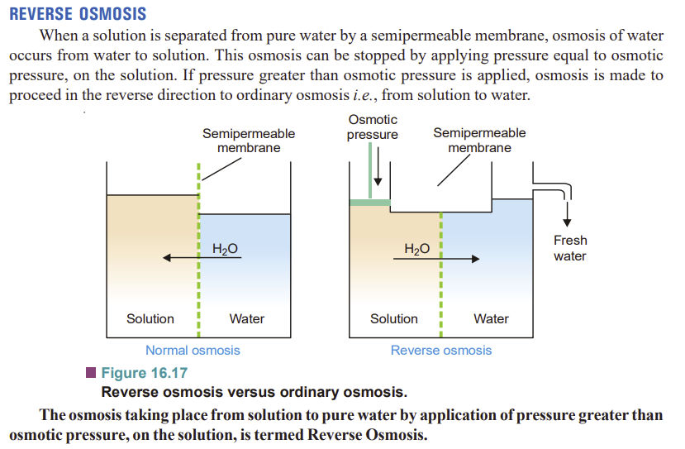

Slide 34
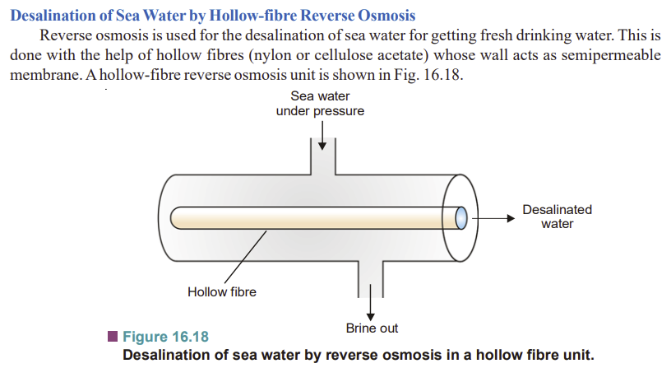

Slide 35
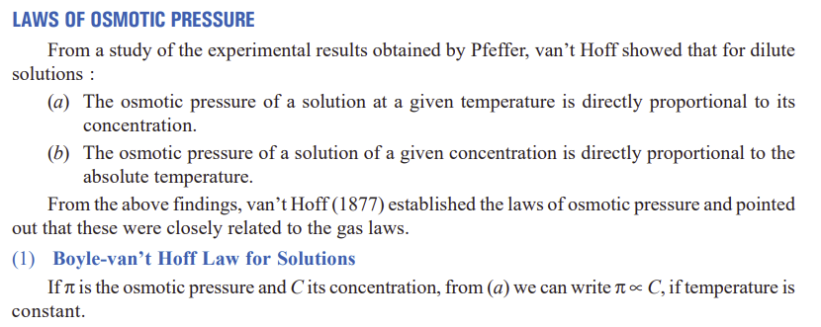
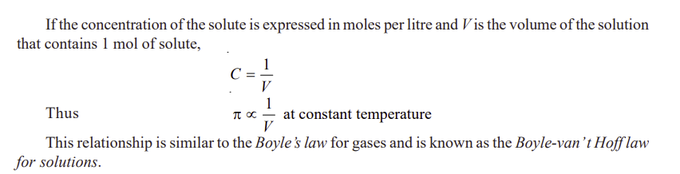

Slide 36
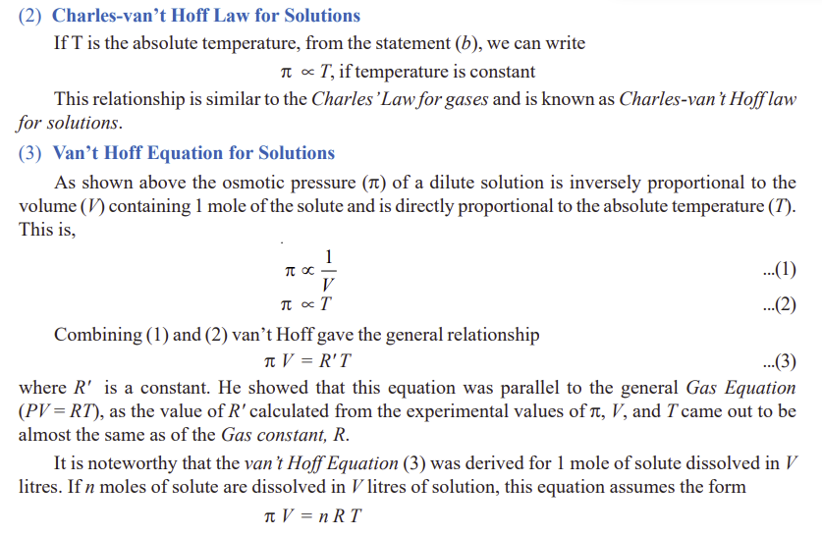

Slide 37
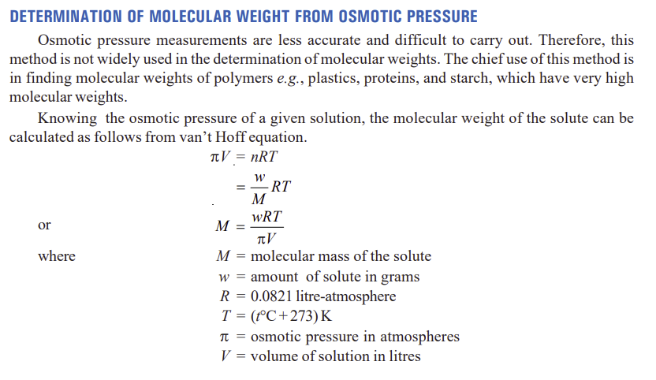

Slide 38
1. Define colligative properties. State Raoult’s law and derive the Raoult’s law from Lowering of vapour pressure.
2. Describe a method for determining the molar mass of a non-volatile solute by the relative lowering of vapour pressure of solvent.
3. What is the molal elevation constant? Show the relationship between the elevation of boiling point and lowering of vapor pressure
4. What do you understand by depression of freezing point? Derive an expression relating the freezing point depression of a solution with the mole fraction of the dissolved solute.
5. Define osmosis? State van’t Hoff’s law of osmotic pressure and deduce osmotic pressure equation Π = CRT. The symbols have their usual significance.
6. Define osmotic pressure. How molecular weight of a substance can be determined by osmotic pressure method?

Slide 39
1. In a Cottrell determination, 22 g of benzene was used as solvent. The readings on the differential thermometer before and after adding 0.586 g of naphthalene (mol mass = 128), were 1.262 and 1.799 respectively. In a separate experiment, using the same amount of benzene but this time adding 0.627 g of an organic compound X, the temperature readings were 1.269 and 1.963. Calculate the molecular mass of X.
2. Acetone boils at 56.38°C and a solution of 1.41 grams of an organic solid in 20 grams of acetone boils at 56.88°C. If K for acetone per 100 g is 16.7, calculate the mass of one mole of the organic solid.
3. The boiling point of a solution containing 0.20 g of a substance X in 20.00 g of ether is 0.17 K higher than that of pure ether. Calculate the molecular mass of X. Boiling point constant of ether per 1 Kg is 2.16 K.
4. 1.250 g of naphthalene was dissolved in 60 cm³ of benzene and the freezing point of the solution was found to be 277.515 K, while that of benzene 278.495 K. Density of benzene = 0.880 g cm^{–3}, K_{f} = 5.1 K per 1000 g benzene. Calculate the molecular mass of naphthalene.

Slide 40
Note:
Please do the solved problems and practice examples.
Follow the reference book: Essential of physical chemistry by Arun Bahl and Tuli.

